Slide 1
AbD(scan)
Adding users’ perspectives

Slide 2
Workshop on ABD scan: programme
09.30 – 11.00 Start programme – theory
11.00 - 12.00 Use case round 1
12.00 – 13.00 Lunch
13.00 – 13.45 Short National Archives tour
13.50 - 16.30 Use cases round 2
16.30 – 17.30 Wrap up and drinks

Slide 3


What
is archiving?

Slide 4

Information
storage?
Notes:
Archiving is often associated with storing information
On a safe location, for use at some point in time
But storage is just one of the aspects of archiving. If we just store information, it’s not very useful.

Slide 5

Accessible and sustainable information
Notes:
Archiving covers everything that is needed to keep information accessible in a sustainable way
In order to enable the use of that information for future users
Accessibility is a subjective term. Whether information is accessible depends on the nature of the information, its users and its use
Accessibility can be characterised by 5 quality features:

Slide 6

Findable
Notes:
First
Accessible information can be found
A user is able to find the information needed quickly and without too much hassle
Even if he or she doesn’t exactly know which information to look for
Users expect the same user experience as they have with Google and its competitors

Slide 7

Available
Notes:
Second
Accessible information is available
Once found, it should be easy to retrieve the information. Without having to perform complicated actions, having to wait a long time or having to pay an extraordinary sum of money
And access to information isn’t rejected without a good reason

Slide 8

Readable
Notes:
Third
Accessible information is readable
Users have the right tools to open and read information, while the content remains intact
Think about the right hardware and software. Does an average user still have floppy or CD drives, or software to open Wordstar files?

Slide 9
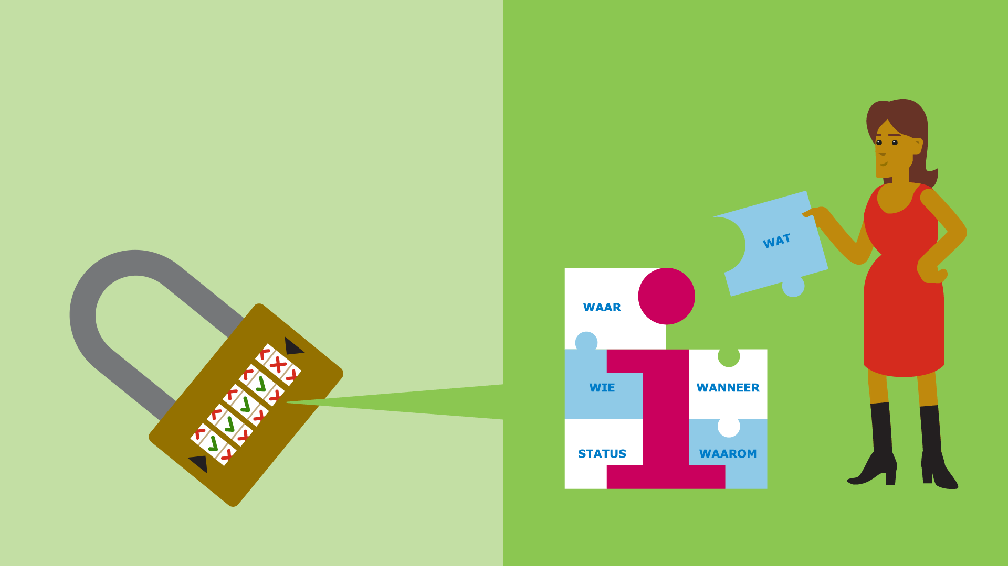
Interpretable
WHAT
WHERE
WHO
WHEN
STATUS
WHY
Notes:
Fourth
Accessible information can be interpreted
A user can give meaning to the information he or she reads
Because the context in which the information is created and used is known, for example
The date of creation, the responsible agent, the activity of which it is the result
The status of information

Slide 10

Reliable
Notes:
Fifth
Accessible information is reliable. This is generic term covering aspect such as integrity, authenticity and security.
Users can be confident that information is
Created and captured at the moment and by the agent as stated (in the metadata)
Authentic and integer
The provenance of information should be known, in order to know whether the information is still reliable.

Slide 11

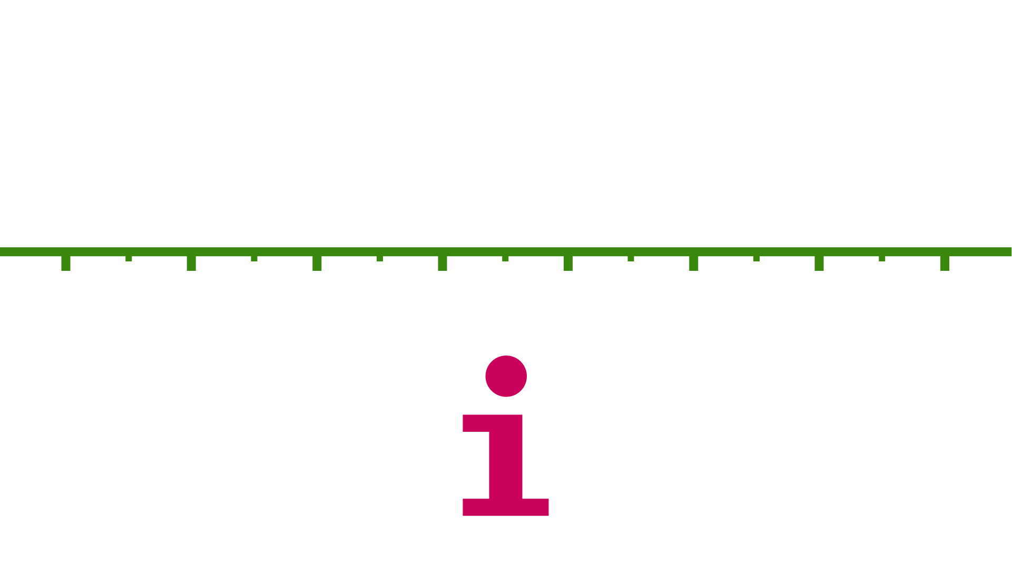






Future proof
Notes:
Accessibility is sustainable when it is resistant to change, or has a proper way to cope with change.
In a way that information will be accessible in the future.
Think about
Changes in information carriers. Floppies were standard at some point, but not used anymore nowadays.
Organizational changes
File format changes as a result of obsolescence. Think about WordStar..
Changing user requirements, for instance related to search. From card indexes to Google, how will we search in the future?
We can’t predict the future, but we can anticipate on it
By using robust techniques which have proven themselves and are used often. For instance open standards
And by exploring new technologies and insights

Slide 12
Why
Archiving?
Notes:
Archiving costs money and can be bothersome. Some ask the question: what is the business case for archiving. Or: why should I archive information?
There is no straight answer to this question. The answer will depend on the nature of information, the people using the information and their reasons for use.
An invitation for a drink isn’t as important as the proceeding’s of the government.
Each organization needs to make a business case for itself. We can indicate the different interests which can be considered.

Slide 13


Notes:
It can be very annoying when information isn’t accessible. For instance:
A colleague is ill and you need to take over his or her task. Are you able to find the right document to work on?
You are in a board meeting and you want to know what has been decided in last year’s meeting. Are you able to find this information reasonably fast?
An audit service is investigating a large IT project executed two years ago. They ask about all relevant project documentation, remember where they were stored?

Slide 14



Information is valuable
Notes:
All these examples illustrate that information, even legacy, is valuable.
There are four main reasons to keep information accessible

Slide 15

Job execution
Notes:
First, employees need information to do their jobs properly
For example:
An engineer needs to know where the facilities in a building are located
A researcher needs data to do analysis and needs to know how to interprete the data

Slide 16


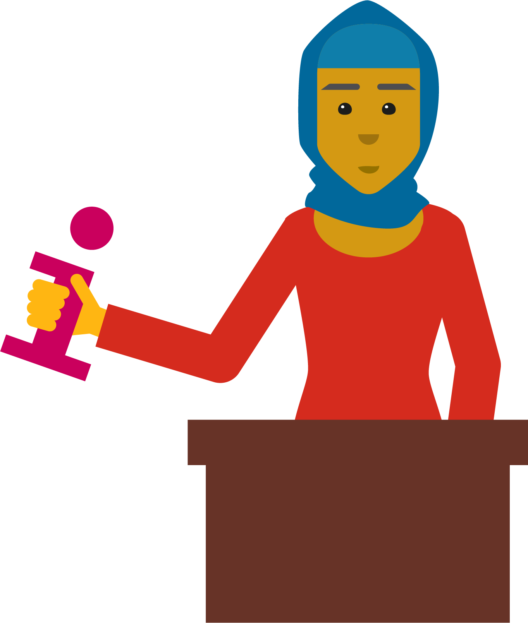
Accountability
Notes:
Second
Government organizations are accountable for their actions. They owe this to society. In addition, transparency is a driver for a better performing government.
Organizations may be required to disclose information, if not already done so proactively, through
FOIA requests
Parliamentary investigations
Management reporting
Audit reports.

Slide 17
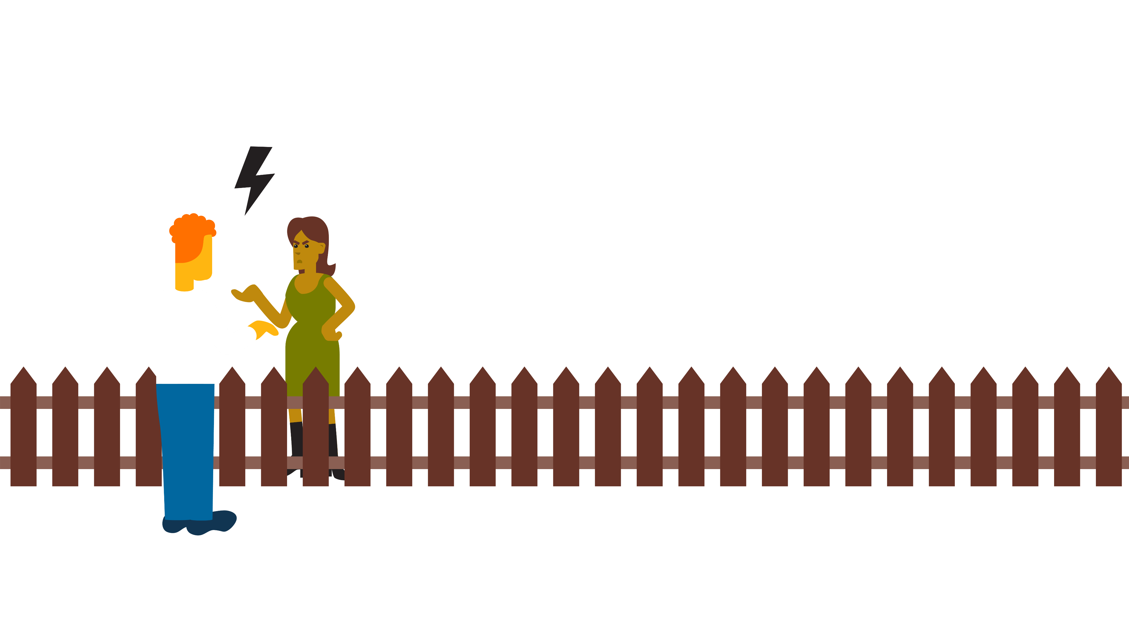

Legal protection
Land registry
Notes:
Third
As a citizen or company you would like to know your rights.
For instance:
You need to be able to find out whether your neighbor's fence is on your property or not
Diploma’s or certifications need to be registered properly

Slide 18

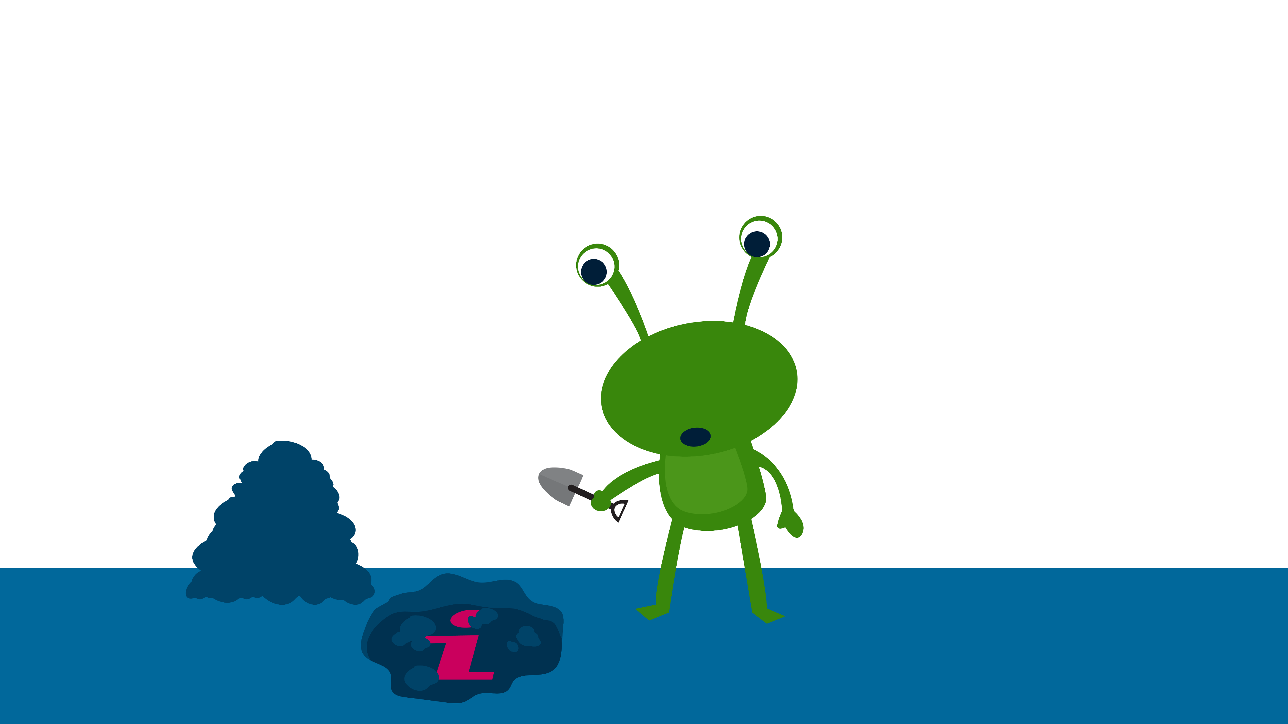
History
Notes:
Fourth
We need information to do historical research
For instance:
About past proceedings in parliament
Historical climate research based on logs of the East India Company

Slide 19







Information in all forms
Notes:
Spreektekst:
Sustainable accessibility is relevant for all information created or received by an organization as a result of its business activities
That is, all information regardless of its form, regardless the application in which it resides
Think about documents, photos, movies, websites, tweets, whatsapp messages, database files etc
It doesn’t mean that everything needs to be kept. All forms may be relevant
Think about
SMS and WhatsApp whatsapp messages which have been exchanged as part of the acquisition of a Rembrandt painting by the Dutch government.
Social media posts as part of evidence in a court case

Slide 20
How
to archive?

Slide 21
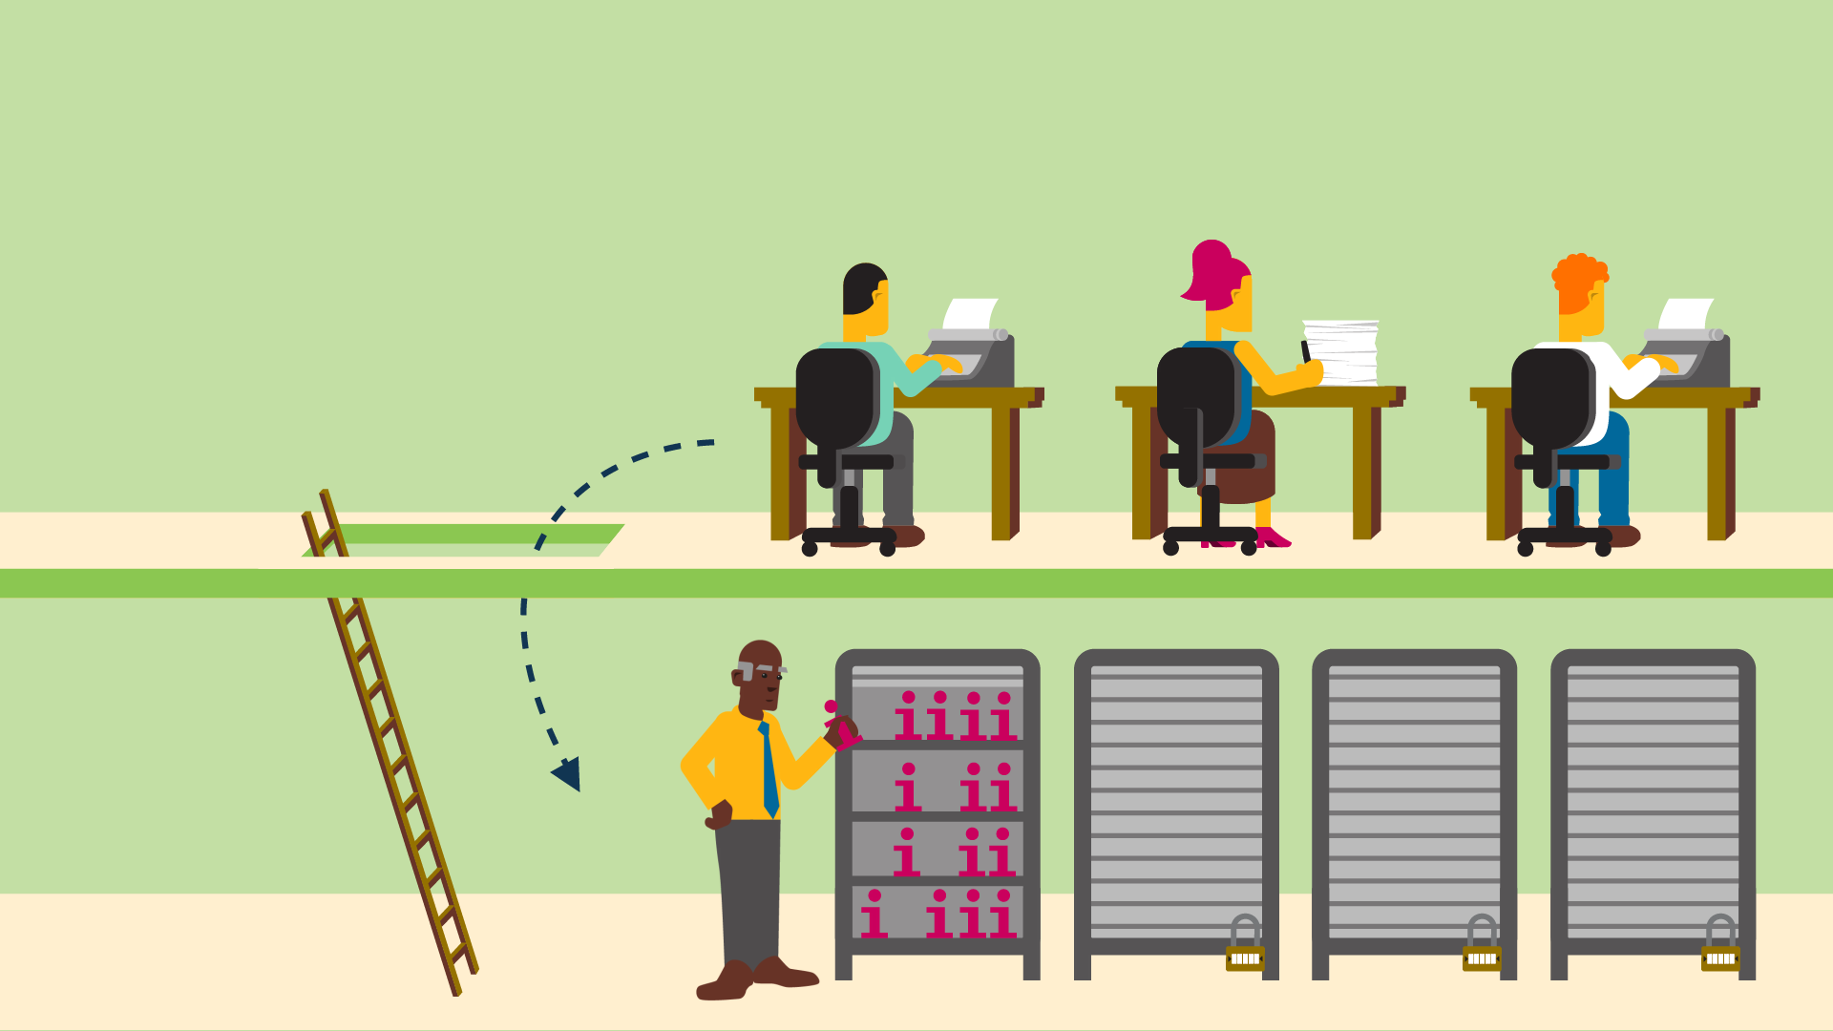

Archiving,
once
Notes:
In the paper era, archiving was done afterwards. Work done, file was transferred to the archive, somewhere in the organization. Maybe even in another building.
When the file was needed again, you had to go to the archive to request it.
So the information was accessible for others only after work was done, but at the same time less accessible for those who created it.

Slide 22
Archiving,
now/future
Notes:
With digital information, migration to a seperate archive should not be necessary after finalizing work.
Information can be made accessible within a business application, for everyone who is entitled to it. Information may remain in the same system in which it has been created.
Information resides in multiple systems.
This implies that information systems have the means to support accessibility in a sustainable way.
As digital information is growing exponentially, it is necessary to make the right arrangements in systems before information is created. It is hard or even impossible to do it afterwards.
This is where archiving by design enters the stage.

Slide 23
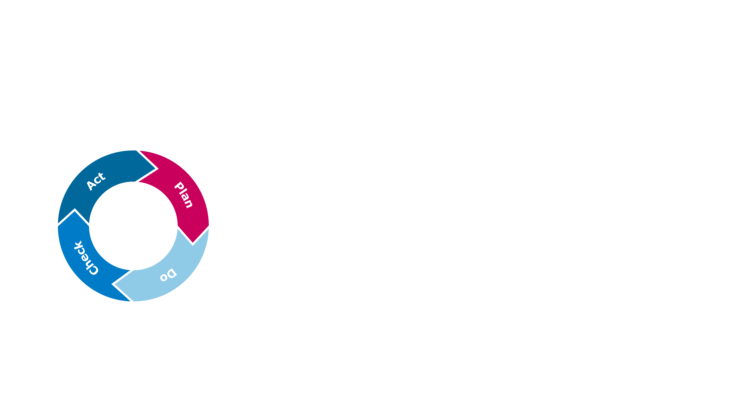


Archiving
by design
Make choices in the design phase
Think about
future use
Look at the future
Notes:
Archiving by design is about making choices on meeting requirements for sustainable accessibility during the design phase of a information system, in support of one or more business processes.
With regards to the requirements: think from a users’ perspective. Which interests do they have and how would they want to access information?
Finally , anticipate on future developments. Make sure not to fully depend on current technologies, vendors and/or employees.

Slide 24
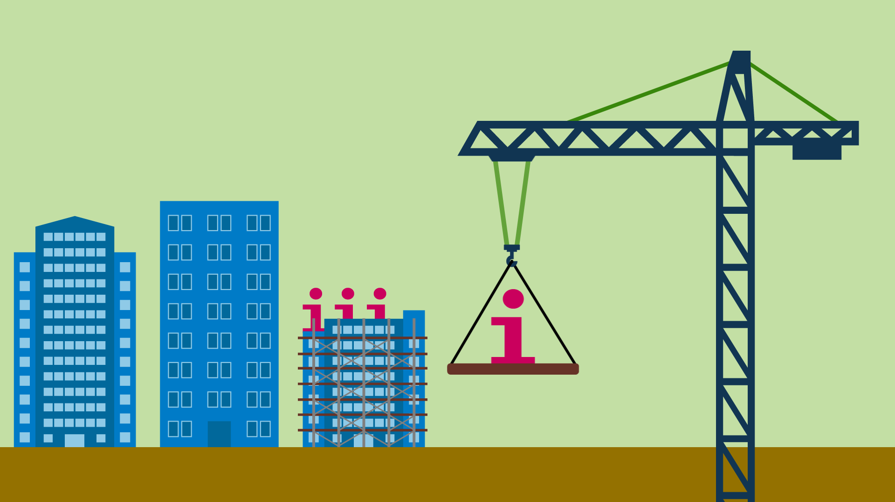
New information systems
Notes:
By design means that requirements for sustainable accessibility should be on the agenda when change is about to happen
For instance, when implementing new or redesigned processes, reorganizations, or a replacement of existing applications. With such occasions, changes can be applied within a project organization relatively easy. This means that requirements for sustainable accessibility can be added to the general requirements for developing new information systems, which may be based on usability and information security.

Slide 25
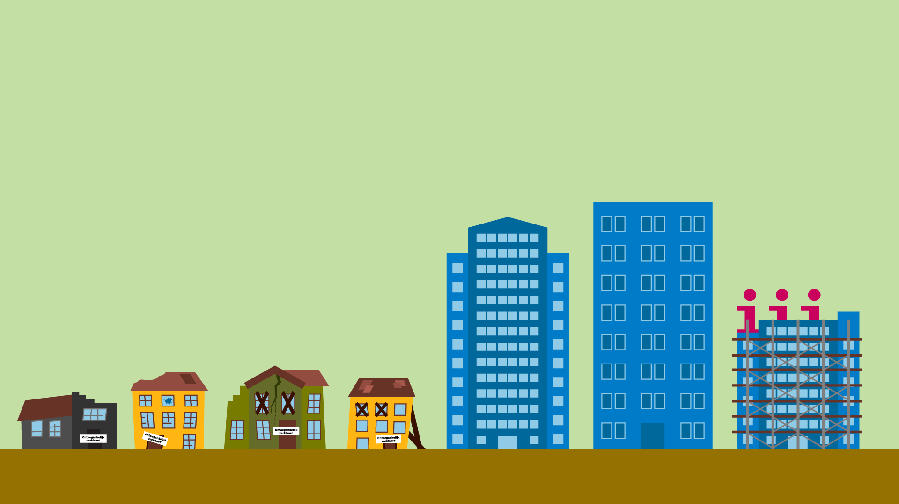
Existing
systems
Inaccessible
Inaccessible
Inaccessible
Inaccessible
Notes:
Accessibility by design is applicable to information that needs to be created. Not to information which has been created already. As a result, the main focus should be on the future.
But, the question remains about what needs to be done with the information that is already in existence.
Information residing in existing systems or systems which have been phased out. Or information on carriers and in formats which aren’t being used anymore.

Slide 26
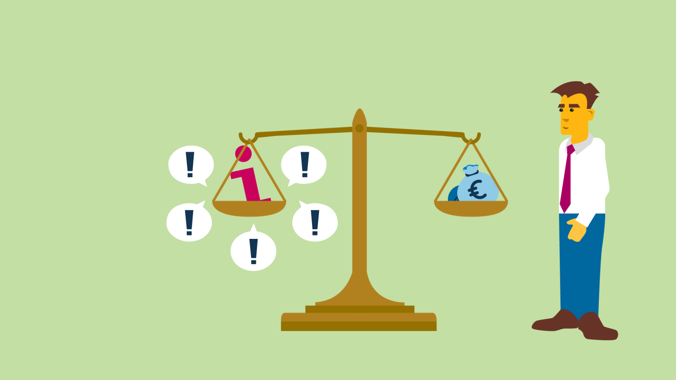
Choices
Notes:
Accessibility of information doesn’t mean that all information should accessible in the same way for ever, though.
That would be far too costly
And it would ignore requirements to disable access to some information. For instance, because of privacy, security or competitive interests
This means that organizations will have to make choices.
Based on requirements analysis and assessment .

Slide 27
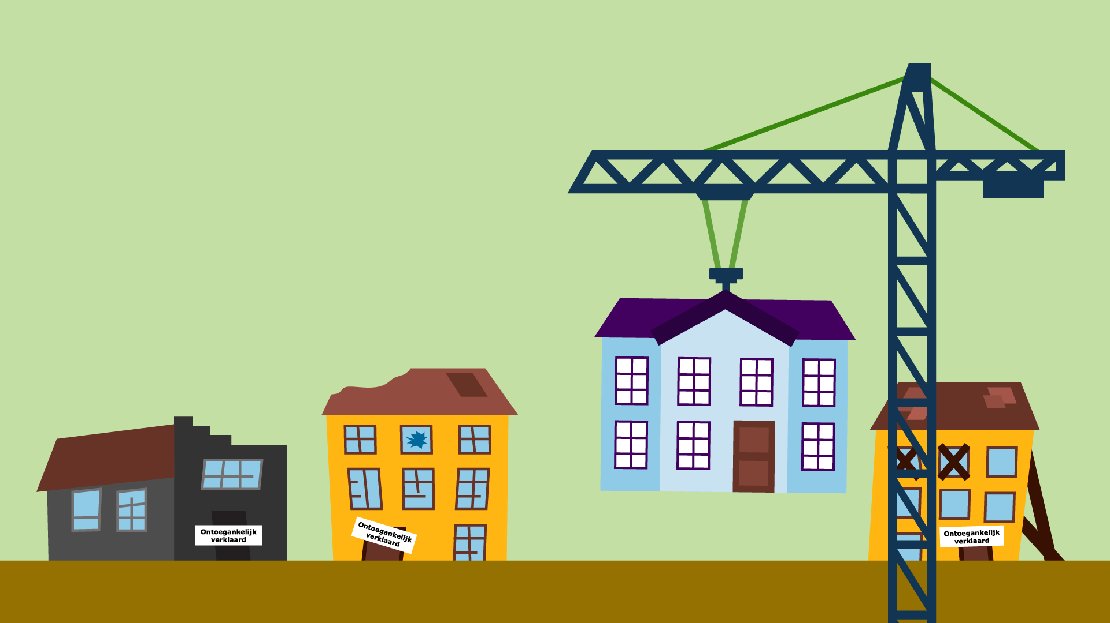
Risk analysis
Inaccessible
Inaccessible
Inaccessible
Notes:
Risk analysis can help to make choices.
For instance: which information is so important that its inaccessibility would be unacceptable? Does this justify bigger resources than for information which is deemed less important?

Slide 28
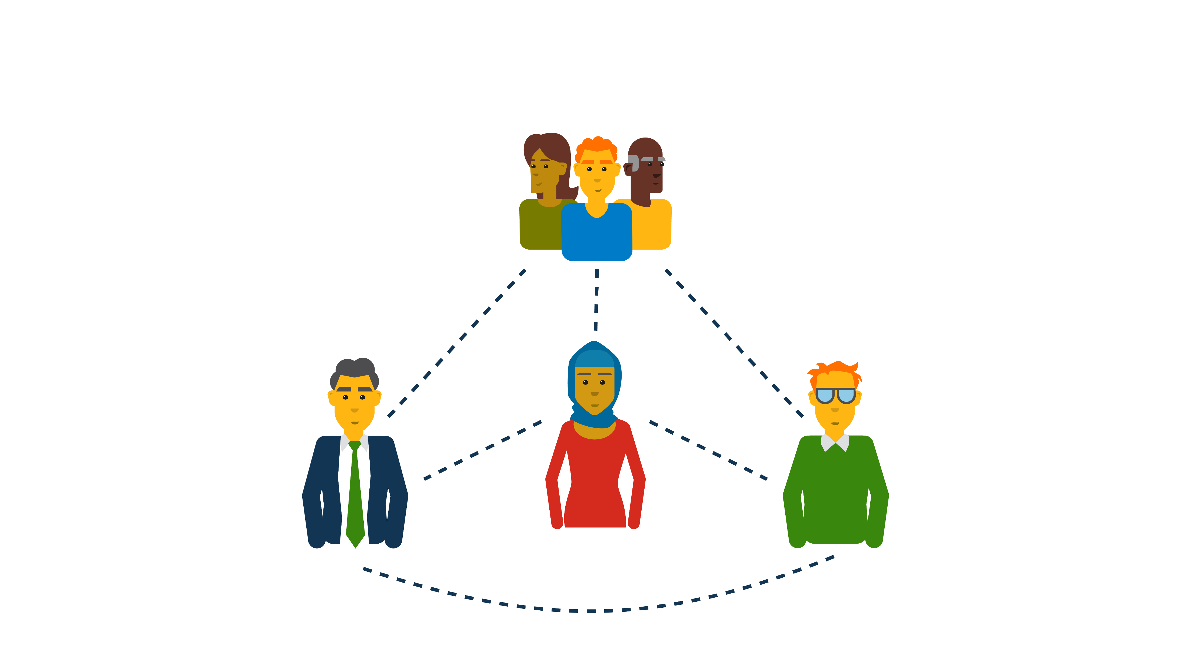
Roles
Users
Requirements
Managers
Decision making, resources and
monitoring
Designers
Solutions
Information managers
Intermediate
Notes:
Everyone has his or her own role in the process of determining and meeting requirements for sustainable accessibility
Information users point out which information should be accessible in which way, for current and future use.
The manager makes decisions, allocates resources (people and money) and monitors activities.
Designers translate user requirements into solutions.
Finally, the information manager is the intermediate between all involved. He makes sure to align everyone and that their interests are respected.

Slide 29
The Archiving by design scan

Slide 30
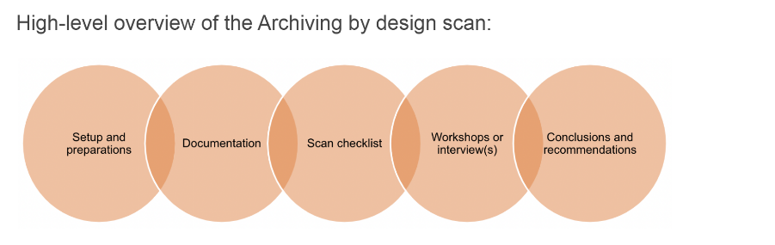
ABD Scan
Five steps:
Setup and preparation
Documentation
Scan checklist
Workshop or interviews
Conclusions and recommendations

Slide 31
Step 1: Set up and preparations
Intake process:
Determine the scope
Determine participants AbD scan
Primary and secondary users
Determine work process(es) involved
Determine the information system(s) involved

Slide 32
Methodology –
canvas
Users of information Current and future users
Context for change Developments causing change in work
processes and/or applications
Work process Activities where information is created or received
Information objects
Created or received
Applications
Used to manage information
output
Input
Notes:
A scan always starts with an intake.
A canvas is used to gain insight in the process, the users, the information objects, the applications and the context of change within the scope identified.
The canvas is the basis for a terms of reference

Slide 33
Step 2: Documentation
Gather documentation about:
Legal framework
Business context
Technical / system documentation
Any other relevant information Examples: Project initiation documents, architecture documents, process descriptions

Slide 34
Step 3: AbD Checklist
10 AbD
requirements
Based on law, regulations, policies A.o. Requirements for metadata, information model, disposal , etc. (overview available on GitHub)
AbD workshop
Explore user needs and create user awareness
Notes:
A source for requirements are the DUTO requirements. DUTO is a guideline and applicable for Dutch central government organizations.
The 13 DUTO requirements have been derived from Archive Law, regulations and government policies and standards. Such as ISO 15489-1 and ISO 23081..
In addition, user requirements can be acquired via a DUTO scan, which is a paid service offered by the National Archives.

Slide 35
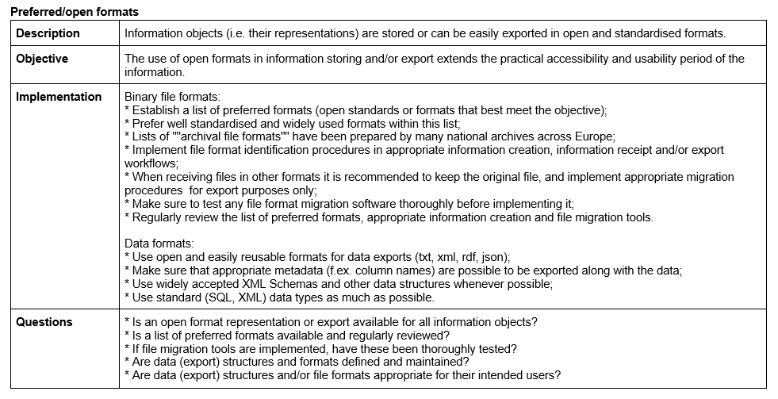
Requirement: Formats
Information model

Slide 36
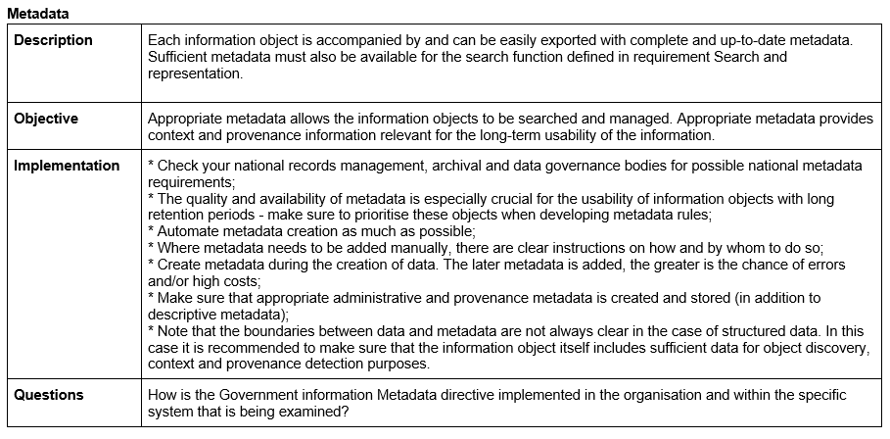
Requirement: Metadata
Information model

Slide 37
Step 4: ABD workshop
What is it?
Methodology to obtain user requirements for (sustainable) accessibility of information
Linked to ABD Quality requirements
Concrete case, scoped
Context for change available
In addition to the 1o generic DUTO requirements
Notes:
A method to identify and assess user requirements is the DUTO scan.
User requirements may differ from legal requirements with regards to accessibility of information. Users may be based in the business, but also be part of society.
In a role as citizen, scientist or as part of a interest group (such as a labour union)
The scope of a scan is usually a business process. Its outcomes may affect other processes or even all business activities of an organization.
An important prerequisite is that there needs to be a context for change. New or changing business processes, new or changing business applications for instance.
If there is no context for change, it is less likely that the results of a scan will be used and implemented.
The requirements are an addition to general DUTO requirements, which are bases on law, regulation and standards.

Slide 38

AbD-scan workshops (Dutch approach)
Workshop 1 users
identification of user requirements
Workshop 2
designers
identification of possible design choices/measures
Workshop 3 users and designers
prioritizing design choices/measures

Slide 39
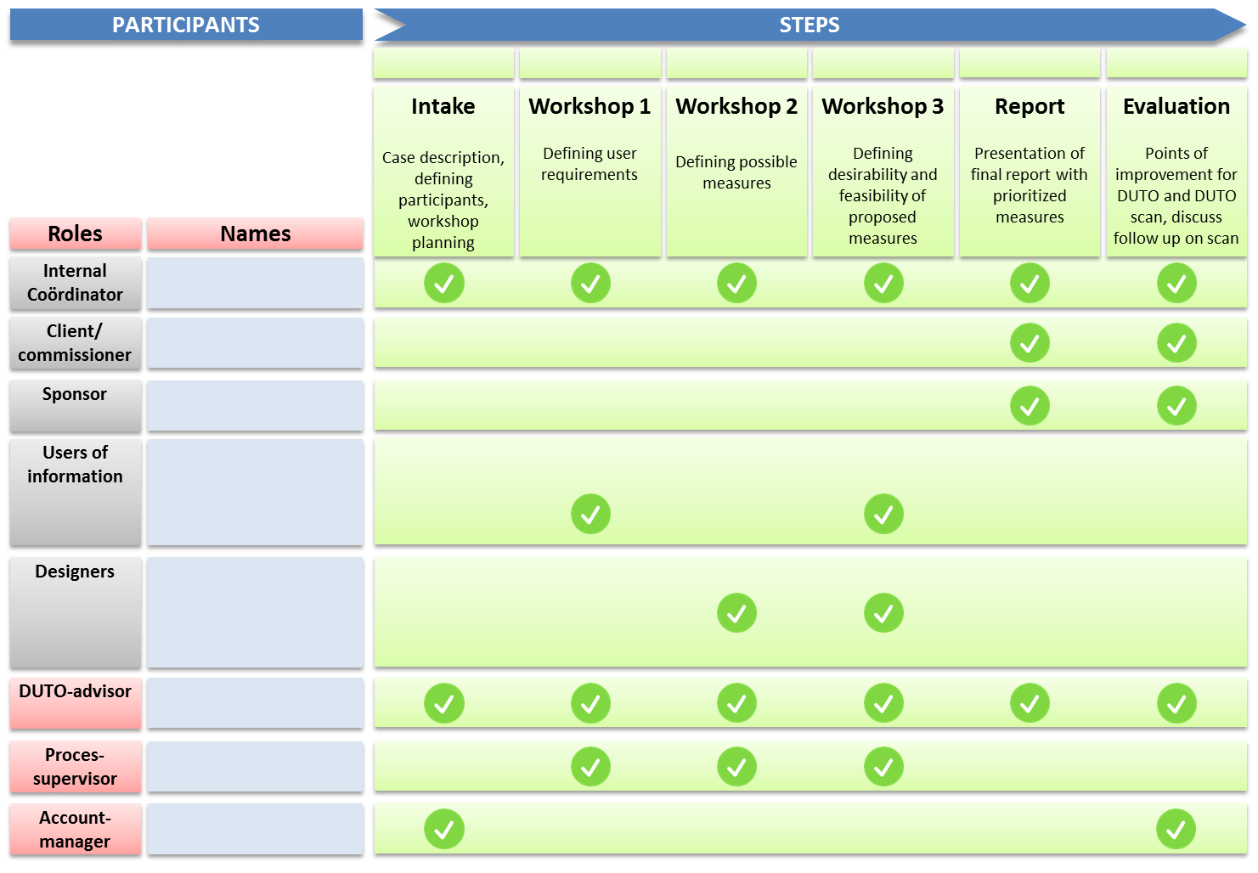

Slide 40

ABD users
creators
users
primary
secondary
Auditors, lawyers, ombudsman, researchers, customers, FOIA officers, etc
Notes:
A DUTO scan is used to obtain user requirements.
Creators of information will be involved in the scan, but not the most important group.usually know where to find information how to use and interpret it. The creators are often also the primary users.
The group of secondary users are the most important users to be involved in a DUTO scan. They didn’t create the information, but have to use it in some way.
Their requirements may differ from the ones primary users and creators will have, so it is important that they become aware of each other.

Slide 41


ABD
designers
Notes:
The term designer is an umbrella term and includes roles such as architects, business analysts and information managers.

Slide 42
Results
Awareness, knowledge sharing and dialogue
Prioritised measures for improved accessibility and sustainability of information within the scope of the scan – Report
Where priority is based on desirability and feasibility
Best practices and examples for ABD itself
Notes:
Users may not be aware of the added value of sustainable accessibility of information. Part of the scan is to raise awareness among the participants
A dialogue is important, as there usually are different user roles with different requirements. It is important that users are aware of each others’ requirements.
The same goes for the dialogue between users and designers.
The proposed and prioritised measures are presented in a report.

Slide 43
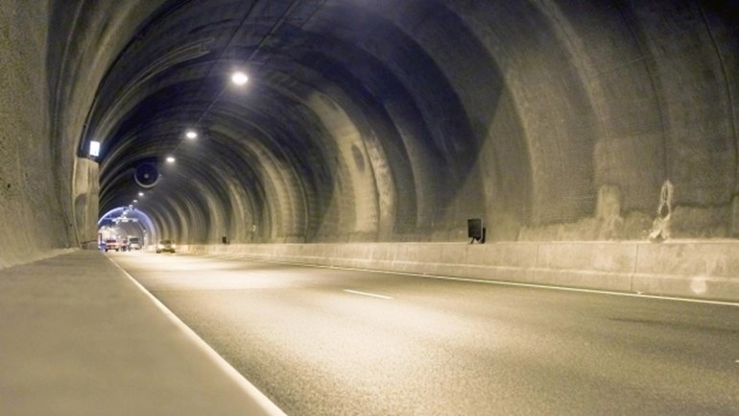
Time for some action
Practice workshop
Use cases based on past scans
Participants will represent a user role

Slide 44
Case 1
‘Tunnel renovation’
Users of information
Context for change
Constructors
Project managers
Accountants
Auditors
Contract managers
FOIA officers
Asset managers
(Historical) researchers
- Program for modernization asset management
Work process
Information objects
Applications
output
Decisions, reports
Designs/drawings/maps
Development plans
FOIA requests
Tenders
Offers
Budgets
Research reports
Contracts
Document management system
Contract management systems
Email (Outlook)
CAD-CAM systems
Project planning systems
Network shares
Project ‘Tunnel renovation’:
Decision making
Project management
Tendering
Bookkeeping
etc
Input

Slide 45

Requirements – user stories
As: <Role>
I want: <Requirement>
so: <Result>
As: a contract manager
I want: a clear overview of all contracts and their expiry dates
so: I can take necessary actions in time

Slide 46
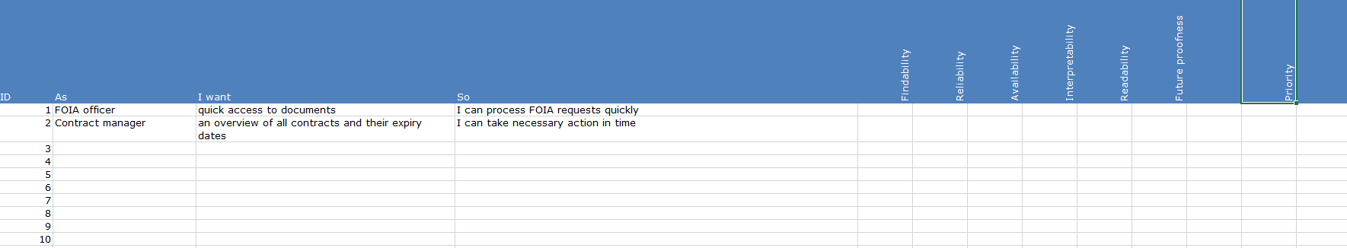
User requirements
Each requirement will be related to one or more of of the characteristics of sustainable accessible information
Users will prioritize requirements

Slide 47
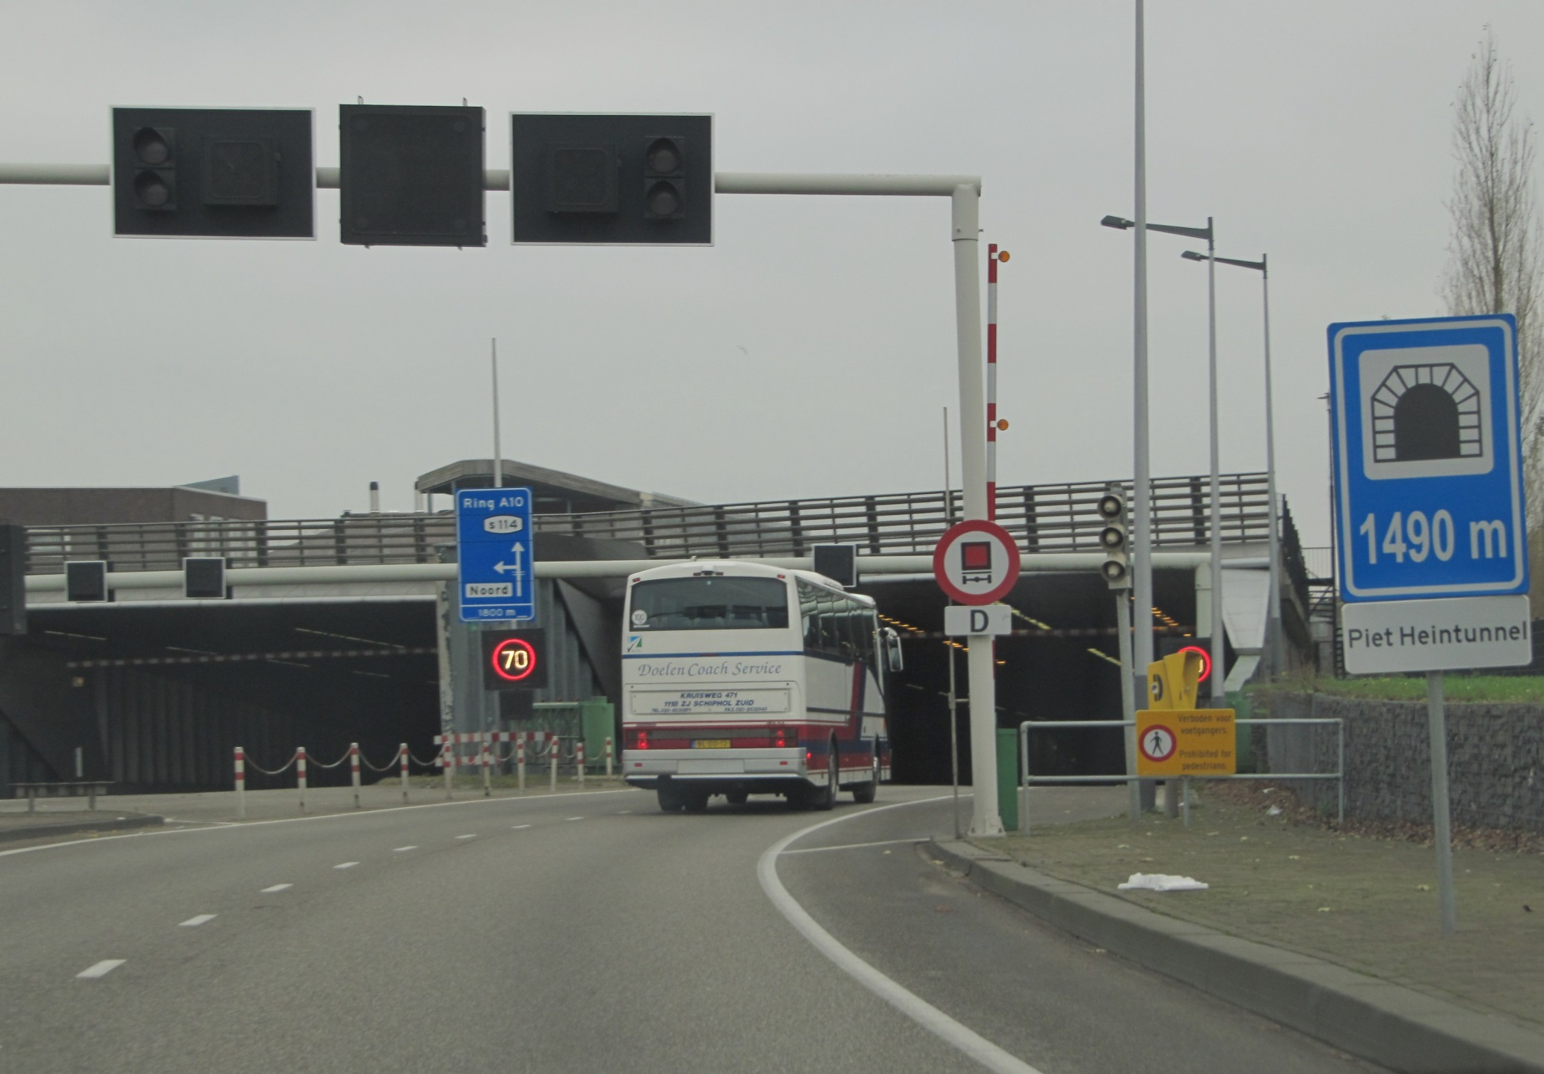
Examples
Some of the user requirements Piet Heintunnel
G1 | (Version) history of information objects can be obtained, depending on relevance
G2 | Information about the dialogue between political decision making and technical planning and execution will be captured and managed.
G3 | Information is available in sustainable file formats. Especially modelling information.
G4 | Accurate and complete metadata is should be applied to information
G5 | Information objects are available independent of data hosting and software systems (no vendor lock-in)
G6 | Information can be searched in conjunction of its context. For example, a contract can’t be interpreted without the context.
G7 | All stakeholders can access relevant information
G8 | There is a legend of technical terms and systems in use
G9 | A user can rely on information being complete and up to date
G10 | Project members have received proper instructions on what they need to do te keep information accessible in a sustainable way.
G11 | Proper search functionality is available to search for information accross multiple systems

Slide 48
Translating requirements into proposed measures
Some of the proposed measures for the Piet Heintunnel case
Prescribe the use of ‘sustainable’ file formats, develop viewers for relevant formats
Use persistent identifiers for each information object and asset
Add relations to other assets in metadata
Create an overall information model
Design and implement central access to information via search functionality
Include location data in metadata of all assets
(future) separate data from business applications
Requirements with highest priority will be looked at first
Measures may be of technical, functional and/or organizational nature
Measures may cover one or more requirements
Feasibility of measures will be looked at in third workshop

Slide 49
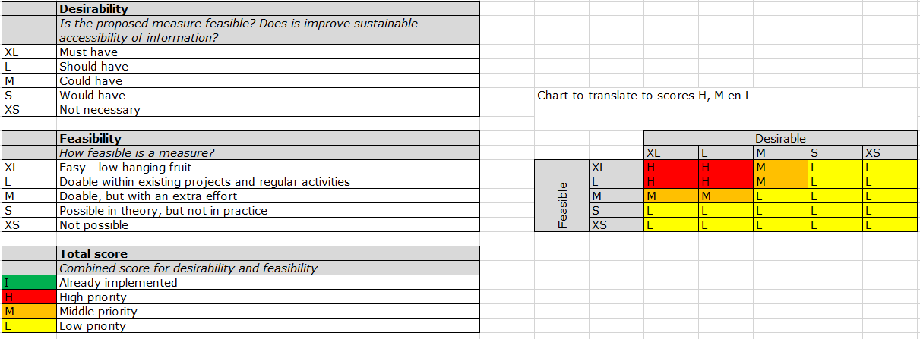
Proposed measures: desirability vs. feasibility
Scores are given by participants from both workshops, using scrum poker cards
Score reflects average score by participants
Dialogue between participants when there is a large deviation in scores for a proposed measure, afterwards poker cards will be used again

Slide 50
Case 2
Users of information
Context for change
Case:
Municipality of ‘Corbulo’
- Maintenance companies
- Disaster prevention specialists
- Accountants
- Those accountable in politics
- Future renovators
- Researchers (historians), for instance on asset management.
- Replacement of Document Management System - Merger with other municipality
Work process
Information objects
Applications
output
Applications
Designs/drawings/maps
Images
Decisions
Reports
Notifications
Zoning plans
Corsa (Document Management System
MS Outlook
Shared drives
Sharepoint
License application process
Input

Slide 51
Context for change - Norwegian customs want to become more data driven
Customs officers
Planners
Management and owner
Control subjects
Media(?)
Researchers (historians)
Information users
Case 3: Controls at the border Norwegian Customs
Performing customs checks
Planning customs checks
External reporting
Appeals
Registered border crossing
Registered check
Control reports
Check plans
Appeals
Answers
Automated vehicle identifying system
Plan and report system (under development)
Appeal form
EDM system
Work process
Information objects
Applications

Slide 52
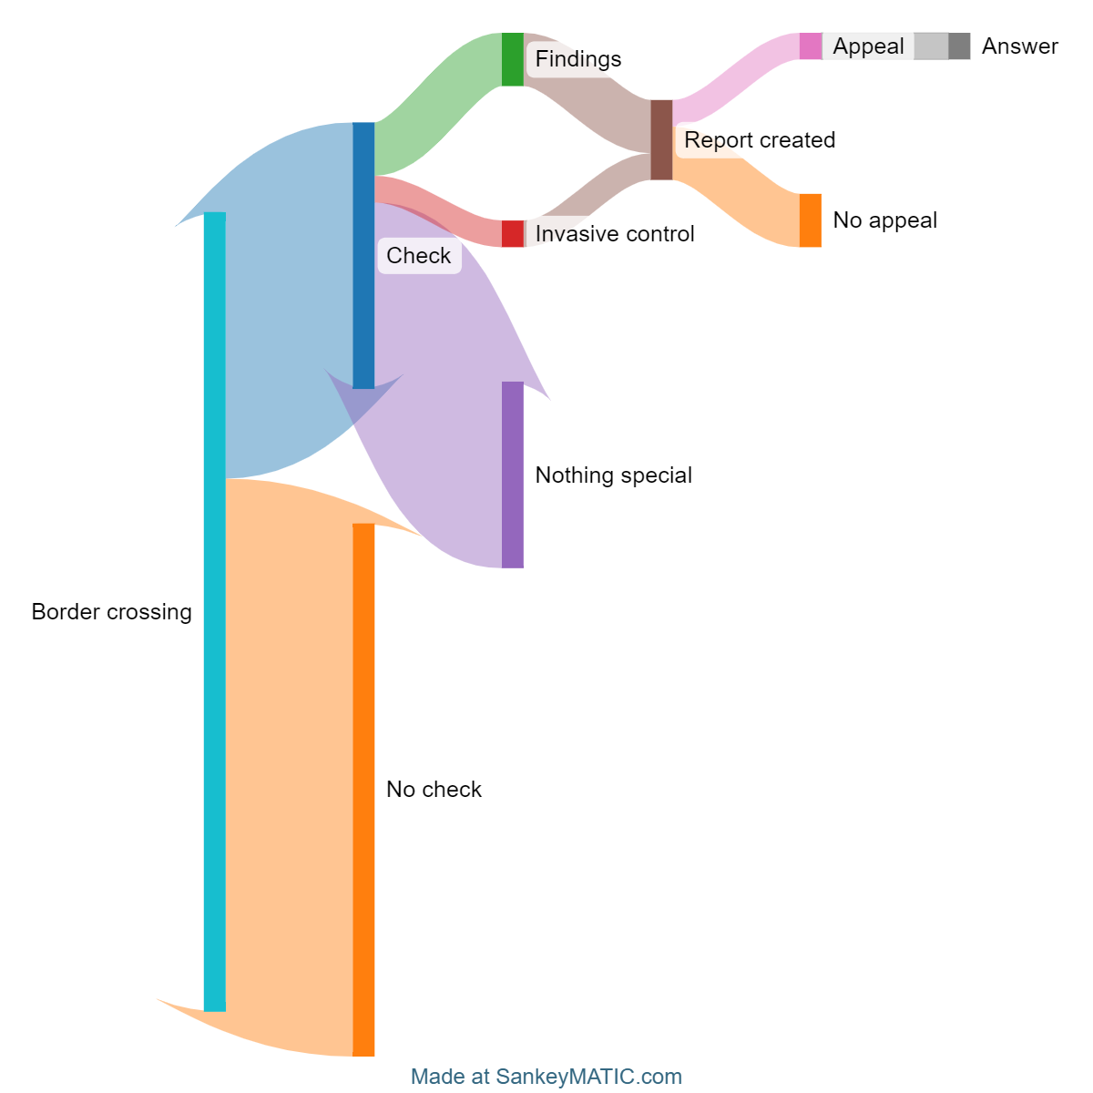
Rough process flow

Slide 53
Case 4
Users of information
Context for change
Case:
Law enforcement agency
- Those handling external
(FOIA, parliament) requests for info
- Asset managers
- Service level managers
- Maintenance companies
- Controllers
- Information specialists
- Integration of control rooms - Revision of communication network
Work process
Information objects
Applications
output
Designs/drawings/maps
Contracts
Asset management information
FOIA requests
Land deeds
Sharepoint
Principal Toolbox
Shared drives
Physical archives (official)
Physical/digital archives (shadow/unofficial)
Aquisition, build, renovation and
divestment of installation points for
communication antennas
Input

Slide 54
Wrap up
What did you like about the workshop?
What could be improved?

Slide 55
National Archives of the Netherlands

